Slide 1
Are you sure your APIs are secure?
Bas Dijkstra
bas@ontestautomation.com
www.ontestautomation.com

Slide 2
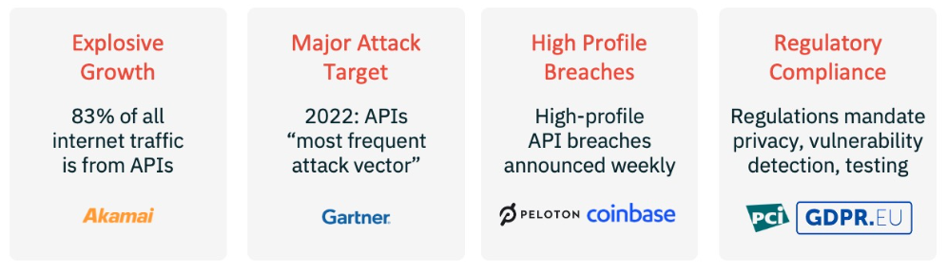
Why API security testing?
Notes:
In the first 8 years of my career I wrote an awful lot of horrible automation

Slide 3
But isn’t API security testing something best left to the experts?
Notes:
In the first 8 years of my career I wrote an awful lot of horrible automation

Slide 4
You can do a lot with common API testing tools and a healthy dose of curiosity and creativity
Notes:
In the first 8 years of my career I wrote an awful lot of horrible automation

Slide 5
Let’s get started!

Slide 6
Exposing sensitive implementation details

Slide 7
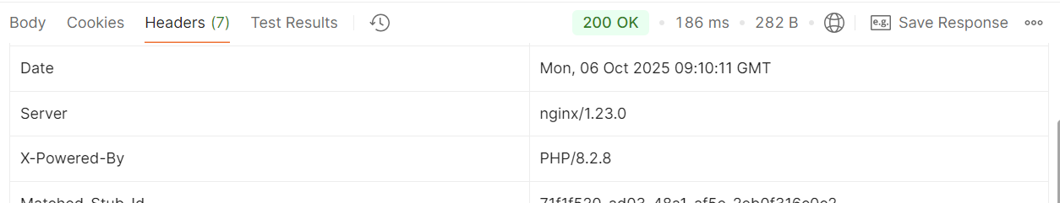
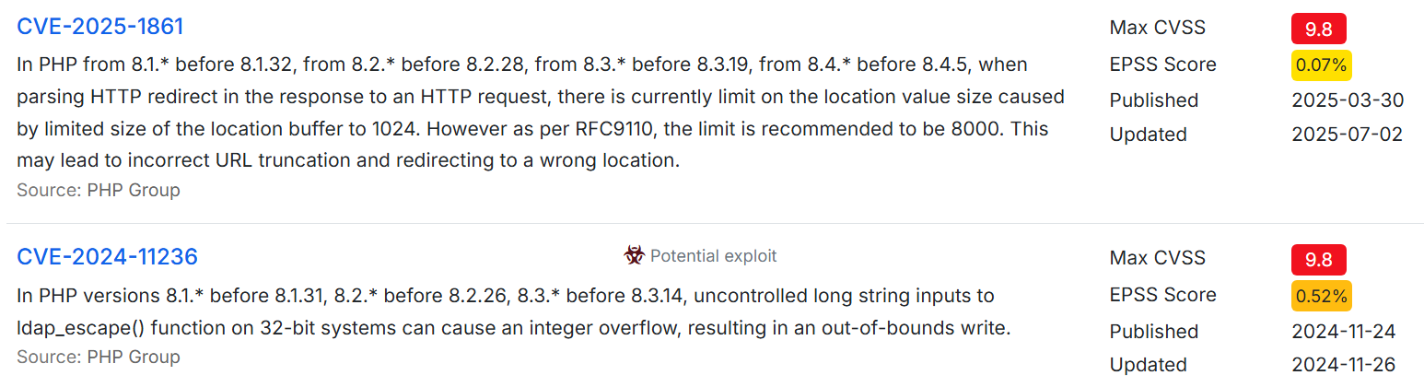
https://www.cvedetails.com/vulnerability-list/vendor_id-74
/product_id-128/PHP-PHP.html?page=1&cvssscoremin=9&order=1

Slide 8
Injection

Slide 9
The Big List of Naughty Strings https://github.com/minimaxir /big-list-of-naughty-strings

Slide 10
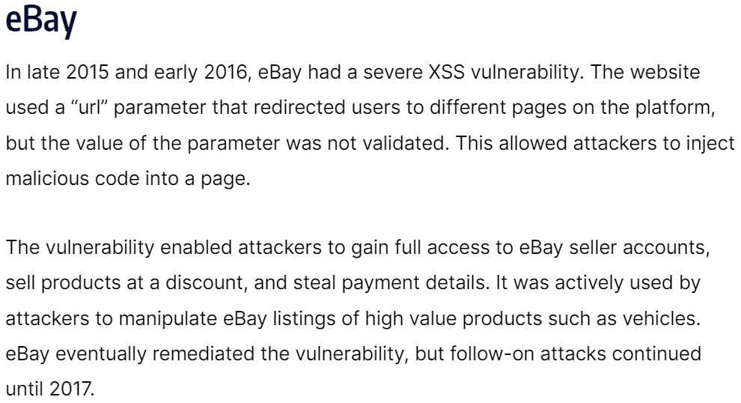

Slide 11
The OWASP API security top 10
https://owasp.org/API-Security/editions/2023/en/0x00-header/

Slide 12
Finding data you shouldn’t have access to – an example

Slide 13
Vulnerability: Broken Object Level Authorization (BOLA) 2023 OWASP API security top 10: #1

Slide 14
Look out for …
Predictable or findable resource IDs
Insufficient or lack of rate limiting
https://owasp.org/API-Security/editions/2023/en/0xa1-broken-object-level-authorization/

Slide 15
Also covered: vulnerability: Unrestricted Resource Consumption 2023 OWASP API security top 10: #4

Slide 16
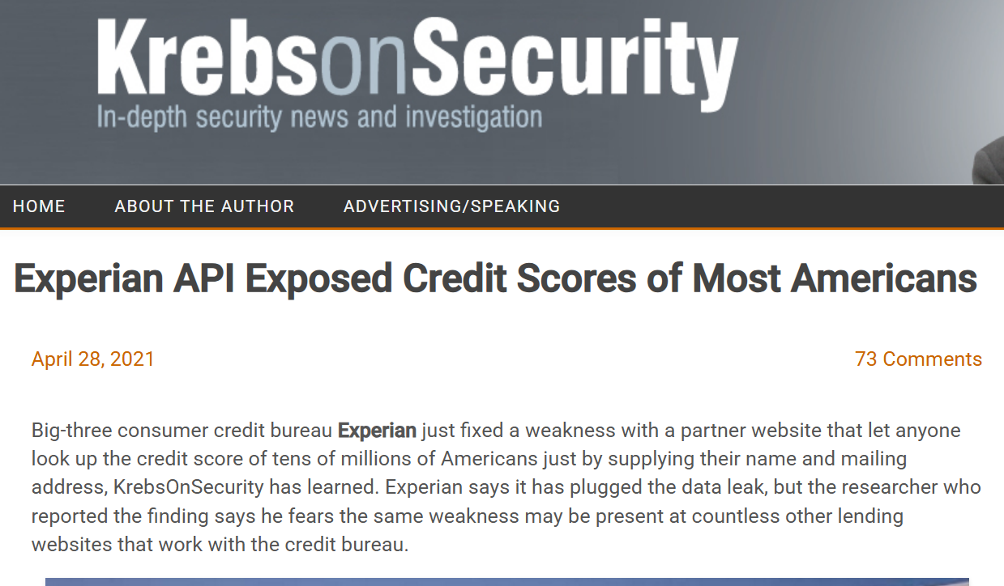

Slide 17
If we can SEE data... Maybe we can MODIFY it, too?

Slide 18
Vulnerability: Broken Function Level Authorization (BFLA) 2023 OWASP API security top 10: #5

Slide 19
Also look out for …
Access to admin endpoints by regular users
https://owasp.org/API-Security/editions/2023/en/0xa5-broken-function-level-authorization/

Slide 20
BFLA is related to BOLA
Both BOLA and BFLA are caused by broken role-based access control (RBAC) implementations
So, if you happen upon a BOLA vulnerability…
… it might be a good idea to check for BFLA, too

Slide 21
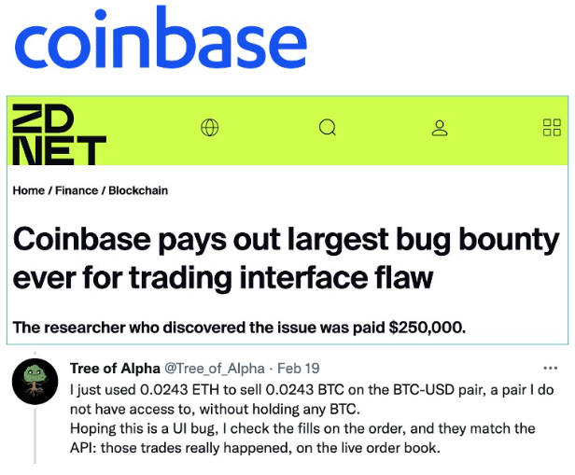
(2022)
Notes:
In the first 8 years of my career I wrote an awful lot of horrible automation

Slide 22
Ordering a limited edition video game

Slide 23
Vulnerability: Unrestricted Access to Sensitive Business Flows 2023 OWASP API security top 10: #6
Notes:
In the first 8 years of my career I wrote an awful lot of horrible automation

Slide 24
Prevention
First identify sensitive business flows…
… then take prevention measures
https://owasp.org/API-Security/editions/2023/en/0xa6-unrestricted-access-to-sensitive-business-flows/

Slide 25
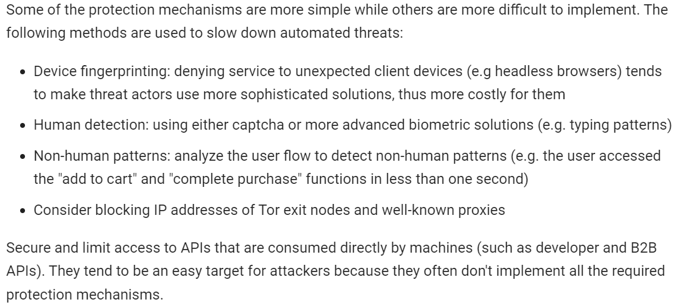
Notes:
In the first 8 years of my career I wrote an awful lot of horrible automation

Slide 26
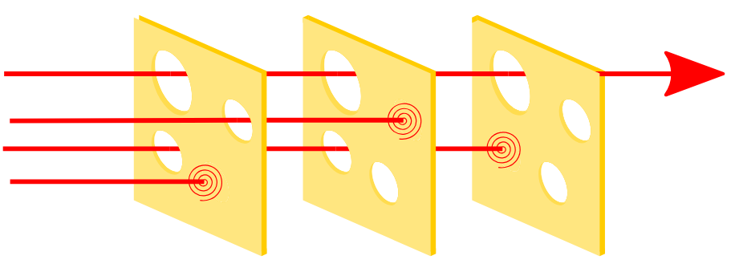
The Swiss Cheese Model in security
Notes:
Speaks for itself, I think.
26

Slide 27
Uploading pictures
Notes:
In the first 8 years of my career I wrote an awful lot of horrible automation

Slide 28
Vulnerability: Server-Side Request Forgery 2023 OWASP API security top 10: #7
Notes:
In the first 8 years of my career I wrote an awful lot of horrible automation

Slide 29
We covered many potential security issues today!
Notes:
In the first 8 years of my career I wrote an awful lot of horrible automation

Slide 30
#1 Broken Object Level Authorization #2 Broken Authentication #4 Unrestricted Resource Consumption #5 Broken Function Level Authorization #6 Unrestricted Access to Sensitive Business Flows #9 Improper Inventory Management
#3 Broken Object Property Level Authorization
#7 Server Side Request Forgery
#8 Security Misconfiguration
#10 Unsafe Consumption of APIs
Notes:
In the first 8 years of my career I wrote an awful lot of horrible automation

Slide 31
The 2023 OWASP API security top 10 entries we missed
Notes:
In the first 8 years of my career I wrote an awful lot of horrible automation

Slide 32
#1 Broken Object Level Authorization #2 Broken Authentication #4 Unrestricted Resource Consumption #5 Broken Function Level Authorization #6 Unrestricted Access to Sensitive Business Flows #9 Improper Inventory Management
#3 Broken Object Property Level Authorization
#7 Server Side Request Forgery
#8 Security Misconfiguration
#10 Unsafe Consumption of APIs
Notes:
In the first 8 years of my career I wrote an awful lot of horrible automation

Slide 33
#1 Broken Object Level Authorization #2 Broken Authentication #4 Unrestricted Resource Consumption #5 Broken Function Level Authorization #6 Unrestricted Access to Sensitive Business Flows #9 Improper Inventory Management
#3 Broken Object Property Level Authorization
#7 Server Side Request Forgery
#8 Security Misconfiguration
#10 Unsafe Consumption of APIs
Notes:
In the first 8 years of my career I wrote an awful lot of horrible automation

Slide 34
#1 Broken Object Level Authorization #2 Broken Authentication #4 Unrestricted Resource Consumption #5 Broken Function Level Authorization #6 Unrestricted Access to Sensitive Business Flows #9 Improper Inventory Management
#3 Broken Object Property Level Authorization
#7 Server Side Request Forgery
#8 Security Misconfiguration
#10 Unsafe Consumption of APIs
Notes:
In the first 8 years of my career I wrote an awful lot of horrible automation

Slide 35
#1 Broken Object Level Authorization #2 Broken Authentication #4 Unrestricted Resource Consumption #5 Broken Function Level Authorization #6 Unrestricted Access to Sensitive Business Flows #9 Improper Inventory Management
#3 Broken Object Property Level Authorization
#7 Server Side Request Forgery
#8 Security Misconfiguration
#10 Unsafe Consumption of APIs
Notes:
In the first 8 years of my career I wrote an awful lot of horrible automation

Slide 36
#1 Broken Object Level Authorization #2 Broken Authentication #4 Unrestricted Resource Consumption #5 Broken Function Level Authorization #6 Unrestricted Access to Sensitive Business Flows #9 Improper Inventory Management
#3 Broken Object Property Level Authorization
#7 Server Side Request Forgery
#8 Security Misconfiguration
#10 Unsafe Consumption of APIs
Notes:
In the first 8 years of my career I wrote an awful lot of horrible automation

Slide 37
Where to from here?
Notes:
In the first 8 years of my career I wrote an awful lot of horrible automation

Slide 38
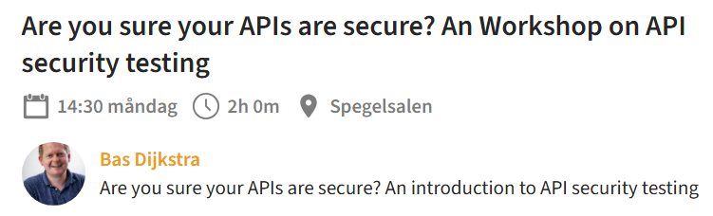
Please bring: * An API testing client (Postman, Bruno, ...) * Recent Java install (check using ‘java --version’) * https://github.com/basdijkstra/api-security-testing-workshop
Notes:
In the first 8 years of my career I wrote an awful lot of horrible automation

Slide 39

https://www.apisecuniversity.com
Notes:
In the first 8 years of my career I wrote an awful lot of horrible automation

Slide 40
?

Slide 41
Contact
Email: bas@ontestautomation.com
Website: https://www.ontestautomation.com
LinkedIn: https://www.linkedin.com/in/basdijkstra

