Slide 1
Are you sure your APIs are secure?
Bas Dijkstra
bas@ontestautomation.com
www.ontestautomation.com

Slide 2
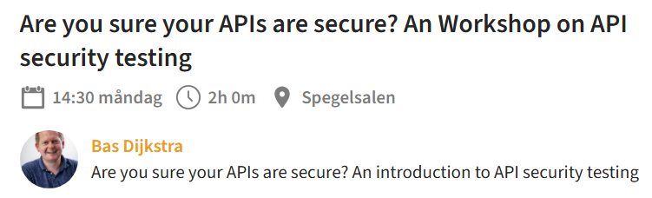
Tech requirements:
* An API testing client (Postman, Bruno, ...)
* https://github.com/basdijkstra/api-security-testing-workshop
* Recent Java install (check using ‘java --version’)
Notes:
In the first 8 years of my career I wrote an awful lot of horrible automation

Slide 3
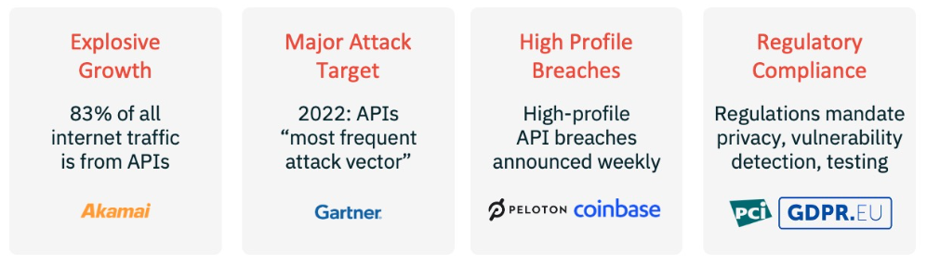
Why API security testing?
Notes:
In the first 8 years of my career I wrote an awful lot of horrible automation

Slide 4
But isn’t API security testing something best left to the experts?
Notes:
In the first 8 years of my career I wrote an awful lot of horrible automation

Slide 5
You can do a lot with common API testing tools and a healthy dose of curiosity and creativity
Notes:
In the first 8 years of my career I wrote an awful lot of horrible automation

Slide 6
Let’s get started!

Slide 7
What happens here?
Start the API mock server
Create a new collection in Postman and add a request
HTTP POST to http://localhost:9876/user?username=john
Can you find a potential security vulnerability here?
How would you report on this issue?
Notes:
7

Slide 8
Exposing sensitive implementation details

Slide 9
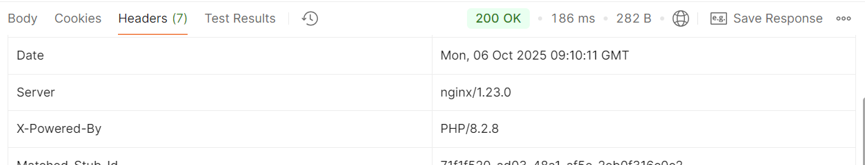
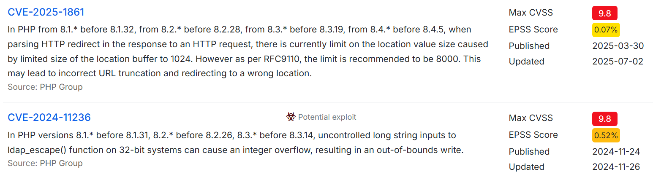
https://www.cvedetails.com/vulnerability-list/vendor_id-74
/product_id-128/PHP-PHP.html?page=1&cvssscoremin=9&order=1

Slide 10
Who wants a burger?
Create a new request
HTTP GET to http://localhost:9876/shops/bobs_burgers/sales
Authentication token: bobs_token
It looks like Bob isn’t doing so well... But what about his competitors?
Can you find a list of competitors and see how they are doing?
How would you report on the security for this API?
Notes:
10

Slide 11
The OWASP API security top 10
https://owasp.org/API-Security/editions/2023/en/0x00-header/

Slide 12
Vulnerability:
Broken Object Level Authorization (BOLA)
2023 OWASP API security top 10: #1

Slide 13
Look out for …
Predictable or findable resource IDs
Insufficient or lack of rate limiting
https://owasp.org/API-Security/editions/2023/en/0xa1-broken-object-level-authorization/

Slide 14
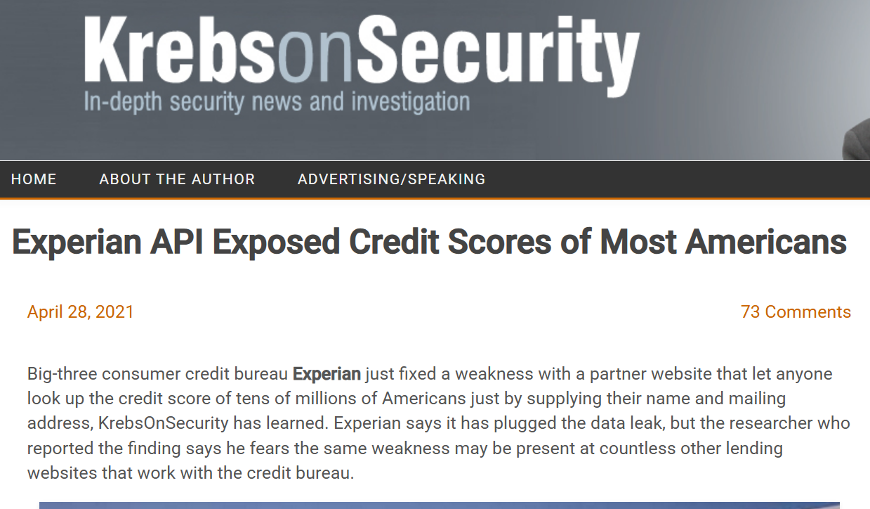

Slide 15
If we can SEE data...
Maybe we can MODIFY it, too?

Slide 16
Now it’s your turn!
Do a GET request to http://localhost:9876/fines/3456
Use ‘max_token_readonly’ as a Bearer token to authenticate
Nobody wants to pay their fines…
…so maybe there is a way to get out of having to do so?
How would you report on this situation?
Notes:
Speaks for itself, I think.
16

Slide 17
Vulnerability:
Broken Function Level Authorization (BFLA)
2023 OWASP API security top 10: #5

Slide 18
Also look out for …
Access to admin endpoints by regular users
https://owasp.org/API-Security/editions/2023/en/0xa5-broken-function-level-authorization/

Slide 19
BFLA is related to BOLA
Both BOLA and BFLA are caused by broken role-based access control (RBAC) implementations
So, if you happen upon a BOLA vulnerability…
… it might be a good idea to check for BFLA, too

Slide 20
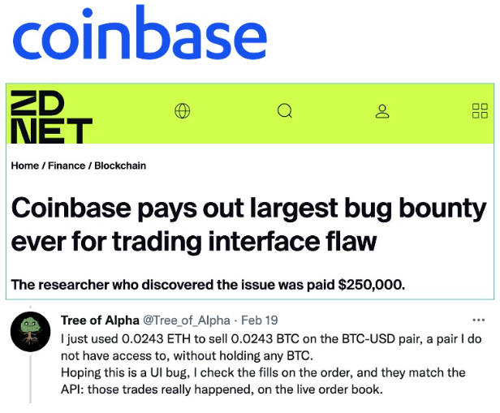
(2022)
Notes:
In the first 8 years of my career I wrote an awful lot of horrible automation

Slide 21
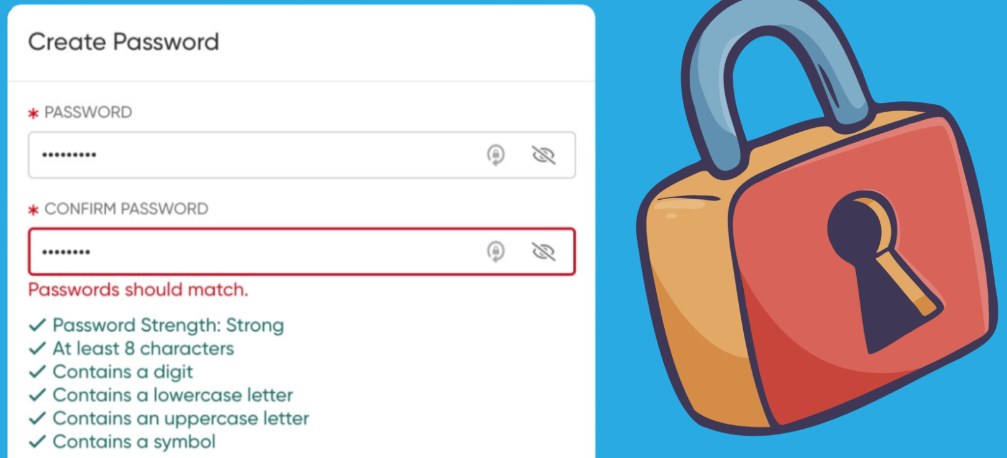
Notes:
In the first 8 years of my career I wrote an awful lot of horrible automation

Slide 22
Now it’s your turn!
Perform an HTTP POST to http://localhost:9876/v2/password
Authentication using Bearer token ‘password_token’ (no quotes)
Request body:
{
“oldPassword”: “abcDEF123@”,
“newPassword”: “<your_new_password>”
}
Does the API use the same strictness as the UI for passwords?
In other words, is authentication broken?
If so, in what way(s)? How would you report on this problem?
Notes:
Speaks for itself, I think.
22

Slide 23
Vulnerability:
Broken Authentication
2023 OWASP API security top 10: #2
Notes:
In the first 8 years of my career I wrote an awful lot of horrible automation

Slide 24
Vulnerability:
Improper Inventory Management
2023 OWASP API security top 10: #9
Notes:
In the first 8 years of my career I wrote an awful lot of horrible automation

Slide 25
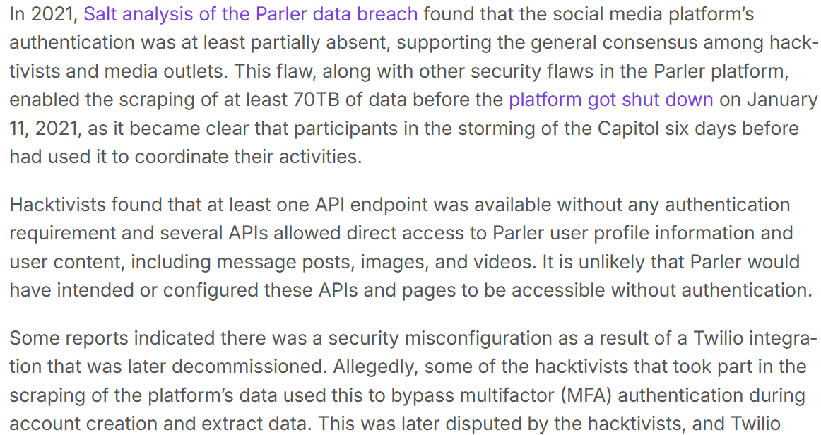
https://salt.security/blog/api2-2023-broken-authentication
Notes:
In the first 8 years of my career I wrote an awful lot of horrible automation

Slide 26

https://www.apisecuniversity.com
Notes:
In the first 8 years of my career I wrote an awful lot of horrible automation

Slide 27
?

Slide 28
Contact
Email: bas@ontestautomation.com
Website: https://www.ontestautomation.com
LinkedIn: https://www.linkedin.com/in/basdijkstra

