Slide 1


Adopt Quality Assistance and Lose Your Job*
A story of 2 QA Engineers in 2 teams over the course of 2+ years
Maile Rohiväli | Cornelia Efros
Notes:
CORNELIA: Hello, good afternoon!
MAILE: Hello, everyone! I hope fika/coffee break was energizing and you’re ready to listen to our tips&tricks on how to become unemployed!
Just kidding, instead we wish to share our journeys on how we increased the quality of our products and processes by adopting a framework called Quality Assistance. And to be (politically) correct, here’s a disclaimer so we don’t get sued haha

Slide 2
* Disclaimer – implementing Quality Assistance may result in increased efficiency, quicker delivery times and deepened domain knowledge. Side effects include Zero Bug Policy, quality ownership and sudden free time. Consult your manager to see if Quality Assistance is right for your team.
Notes:
CORNELIA: <disclaimer> + Okay so now that’s out of the way, a quick intro about ourselves:

Slide 3
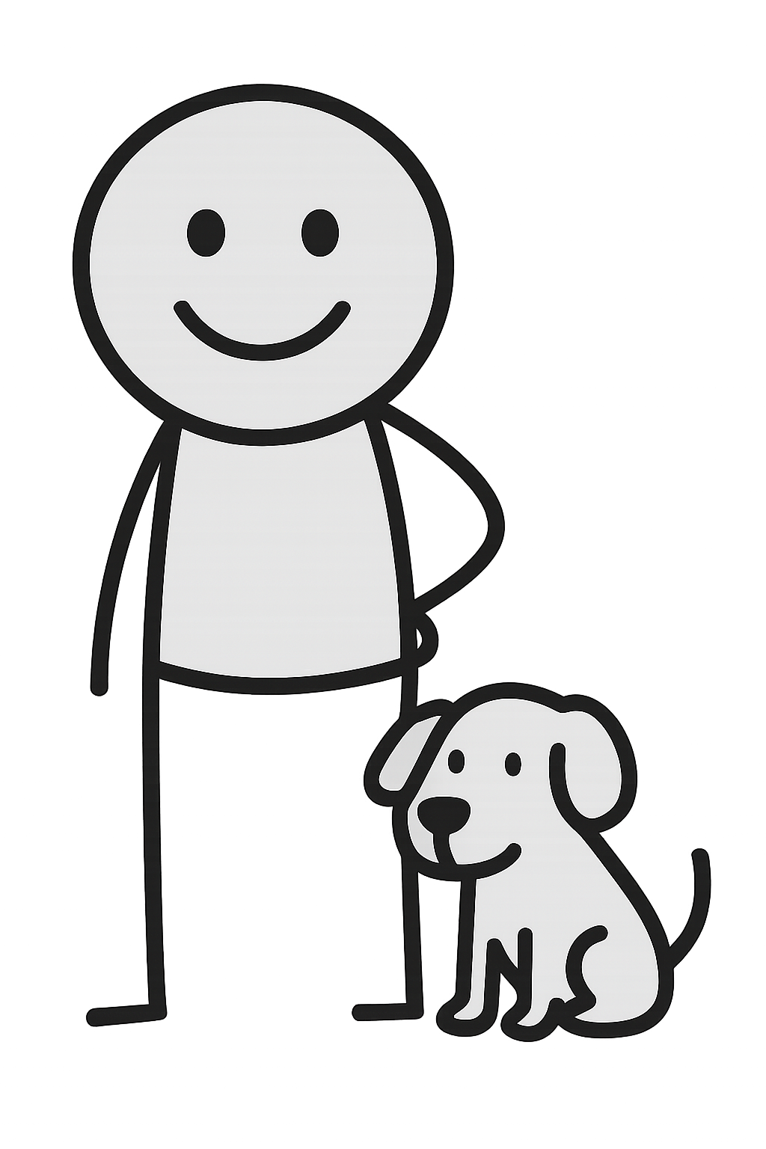
Maile
Over 13 years in IT
Testing with team
Gardening and dogs
Learning to grow my patience

Slide 4

Cornelia
8 years in IT
Writing automation tests
Cookies and handstands
Learning coaching

Slide 5
Quality assistance
Quality engineering
Shift left, shift right
Quality coaching
Notes:
MAILE: Quality assistance, quality engineering, shift left-shift right, quality coaching... Good child has many names. When the principal QA in Rush Street Interactive (in short RSI) first introduced this idea of Quality Assistance 4 years ago it seemed interesting and the seed was planted. To give you better understanding let’s share the background for both of us and our teams. We began working in RSI both in same team 5 years ago. Soon after that team split happened and we both had our own teams, but still in same area.

Slide 6
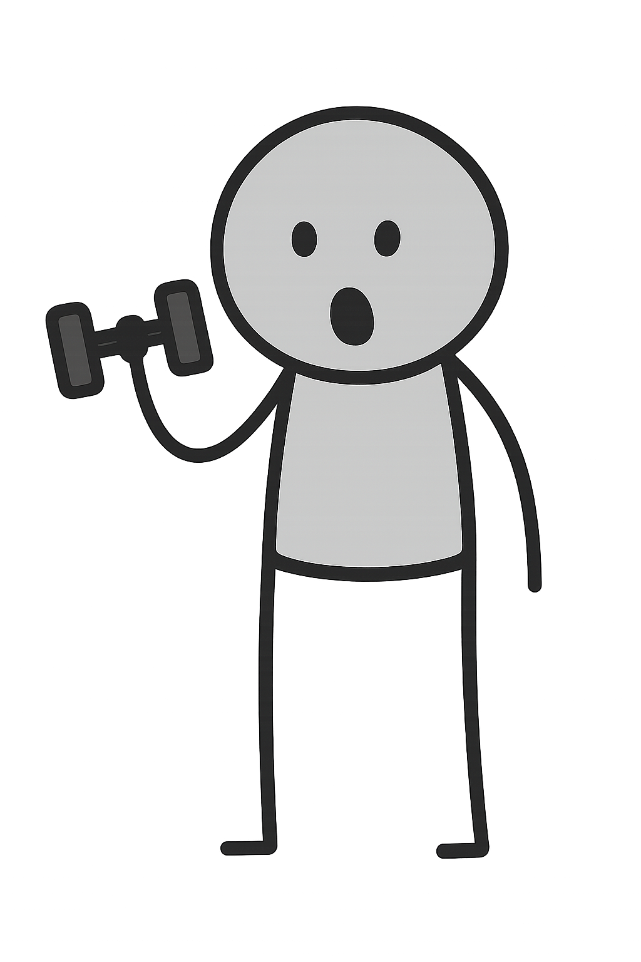
2022
Ping-pong between product and engineering
QA as bottleneck
Little automation coverage
120+ Bugs in Backlog
Notes:
Cornelia: My team was excellent in table tennis, refining sessions took a lot of time, for some tickets we spent an hour together with the whole team trying to understand the problem at hand and what needs to be done. And more often than not the ticket would go back to product table only to be refined again, and again..
Then there was me, a bottleneck in the end of Sprints, frantically trying to test everything at the last minute. Needless to say I felt overwhelmed as that carried on from sprint to sprint much like the unfinished work we couldn't test and hence was carried over to the next sprint.
Automation coverage for new developments was often seen as nice-to-have... Something extra we could maybe write if we had time (which we, surprise-surprise, didn't have most of the time).
Oh and the Bug Backlog was just haunting us with over 120 issues. For the record, our team was one of the first teams in the company so a lot of these issues aged like fine cheese, it's just that we really didn't have the time or the priority to clean them up or take them into work.

Slide 7
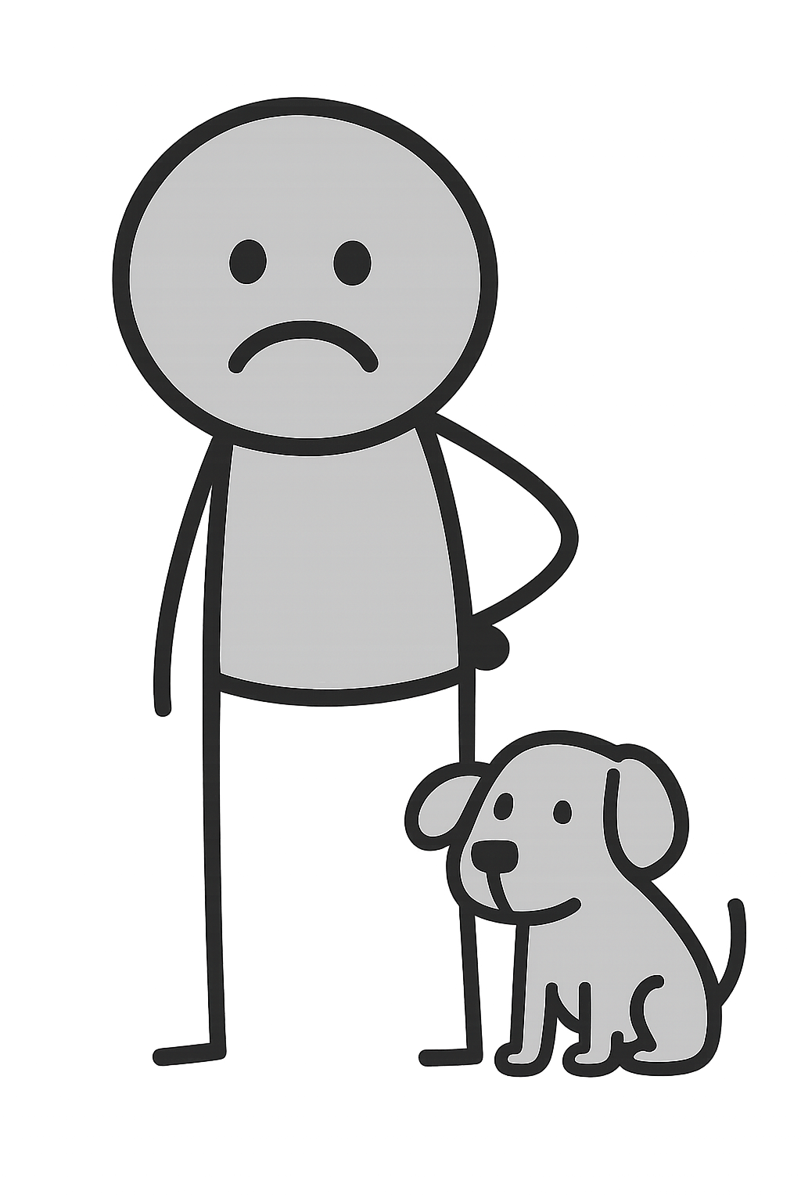
2022
Barely any automation
Manual testing mountain
Nearly quit moment
Notes:
Team split felt like a fresh start, an opportunity to create positive change and start with quality processes in the early stages of development. I quickly began encouraging more automation in our workflow, since unit tests were rare and integration or end-to-end tests were almost non-existent. At the same time, most of the manual testing naturally landed on me.
Our QA approach meant I had to review every single ticket. And because the team was full of high achievers who wanted to complete as many tasks as possible, sprint endings often turned into long nights for me to keep everything on track. I really wanted to shift quality earlier in the process, but progress was slower than I had hoped. It became such a struggle that at one point, I even set myself a date when I would resign.

Slide 8
1-2-3, follow me! Yeah right...
Notes:
CORNELIA: Then came the turning point: RSI hired a staff QA with experience in Quality Assistance, and leadership clearly recognized the limits of the old QA model. That was the spark — the moment the shift truly began. We had someone to guide us with their hands-on experience.
MAILE: I started with having the most difficult person in my team on the same page with me. So this means I had a meeting with them where I introduced the Quality Assistance. A 30 minute meeting turned out to be a 1.5 hour, really intense discussion and I remember that at the end I asked: so you don’t think it is good for the team, worth to try? This person held still for a moment and then answered: I think it is a very good idea!
CORNELIA: Upon having many meetings with my team to introduce the new framework, the developers were rather skeptical and concerned about their testing skills but luckily still ready to try out the new processes.
MAILE: We started experimenting with things like 3 Amigos sessions, walkthroughs, a new bug review, QA kickoffs, testing notes, team regression testing, and even introducing feature and tech leads. If it seems like a huge list of new processes to you, then we agree, it was overwhelming to try all of these out.

Slide 9
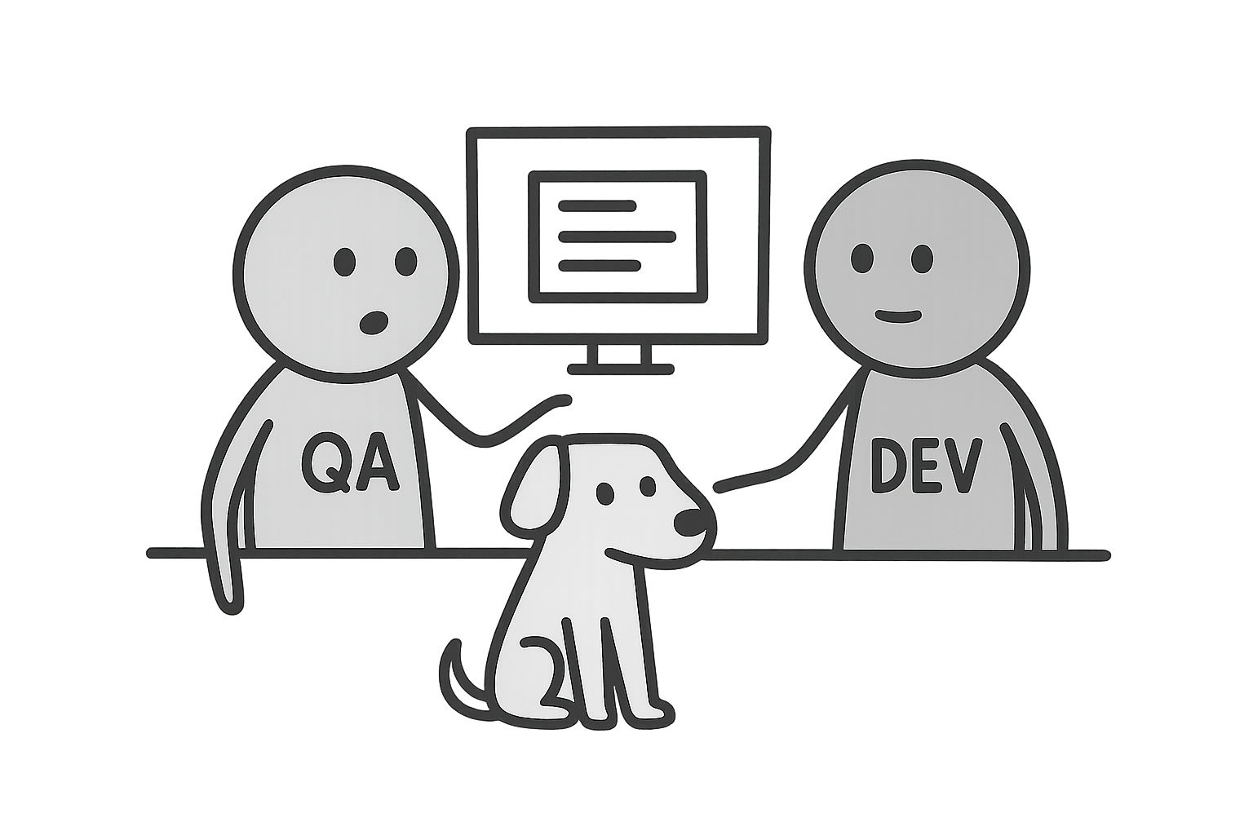
QA Kickoff
Notes:
CORNELIA: DEV and QA pair up early in the sprint for a quick to review implementation ideas and add any needed testing notes to the ticket
I think we practiced QA kickoff in total of 7 times until we ditched it.
MAILE: My team tried a couple of times and it just did not feel right.

Slide 10
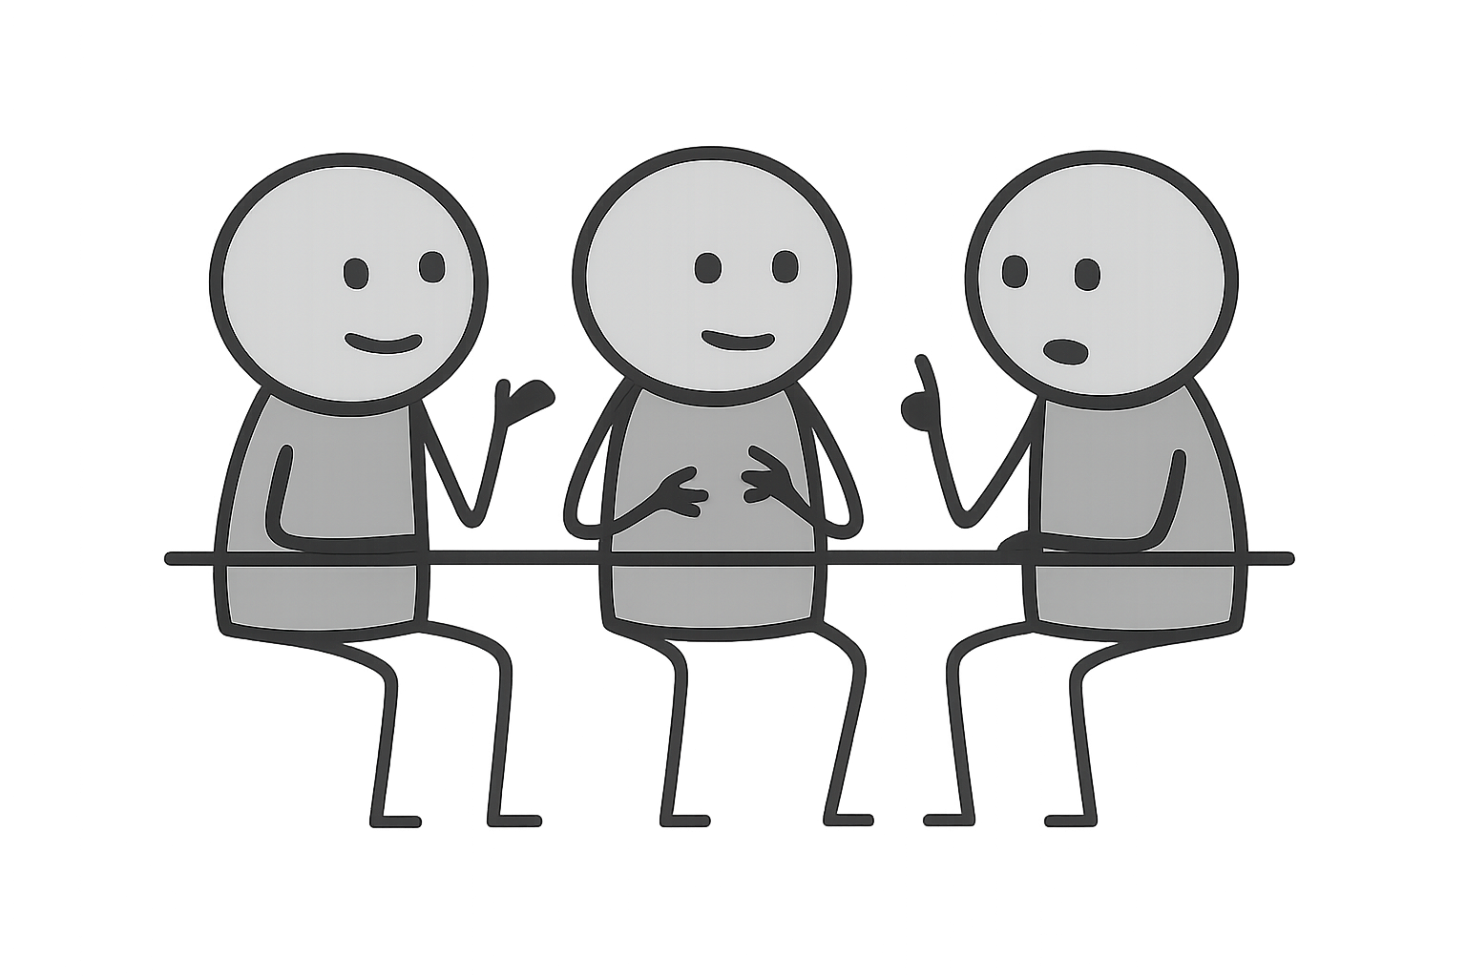
3 Amigos
Notes:
M: The same was actually true for 3 Amigos - three perspectives come together to reach better quality user stories, especially from testing point of view. Team just did not see the necessity of this meeting.
C: We started with more than 3 friends since we wanted the perspective of both server and FE engineers and oftentimes it felt like a regular refining session where we got carried away understanding the issues or discussing the technical solution. Rather than concentrating on the testing perspective.

Slide 11
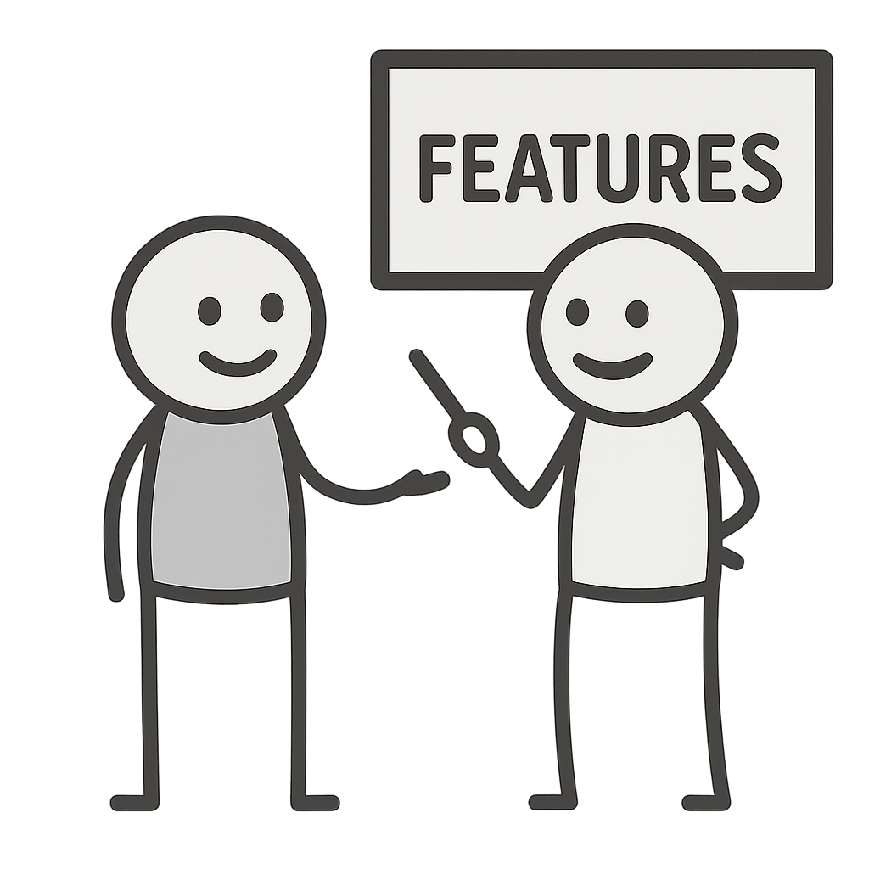
Feature leading
Notes:
MAILE: My team had just started feature leading in our team and since the team was a bunch of high achievers the expectations to feature lead were also high. On the other hand it made much more easier the implementation of quality assistance since feature lead needed to prepare all the tickets for this specific feature and in such condition that they could be refined immediately. Feature lead also had the responsibility to contact PO and QA before the start of the development process if there were some things that needed to be cleared, information missing or testplan created.

Slide 12
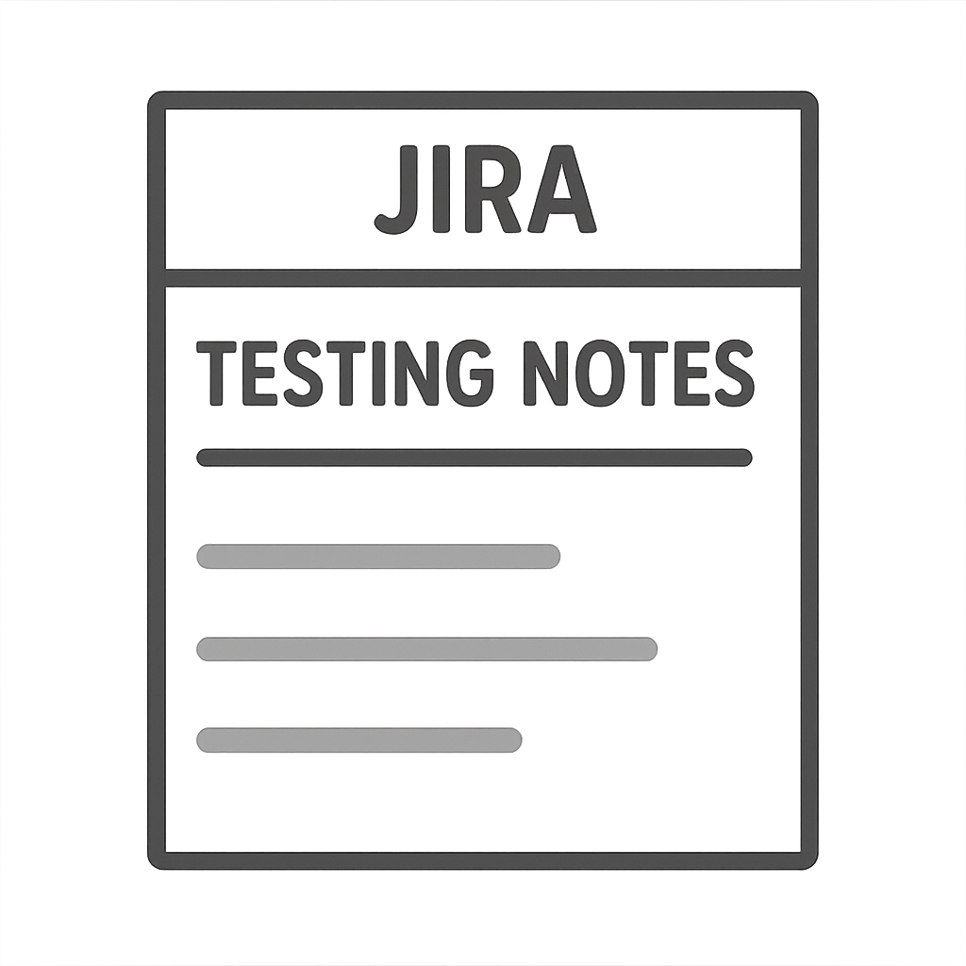
Testing Notes
Notes:
CORNELIA: here I would like to explain two different types of testing notes:
field to Jira tickets. Testing notes are Lightweight guidelines that interpret acceptance criteria from a testing perspective, outlining how the feature should be validated, explored, and monitored. This is to help developers to test while they are writing the code, and also to later validate AC.
The second type is notes about what and where was tested during/after the development which is something we encouraged developers and code reviewers to do so that our walkthrough sessions (which Maile will explain in a second) would go smoother and quicker.

Slide 13

Walkthrough
Notes:
MAILE: Started doing walkthroughs: PO, DEV and QA review a finished story together, demo the functionality, test acceptance criteria, and catch bugs while the code is still fresh. At first it got the developers worried about the extra time spent, but eventually it turned to excitement about the possibility to showcase their developments. As a bonus, PO could quickly accept the tickets and we could move on to next developments quicker.

Slide 14
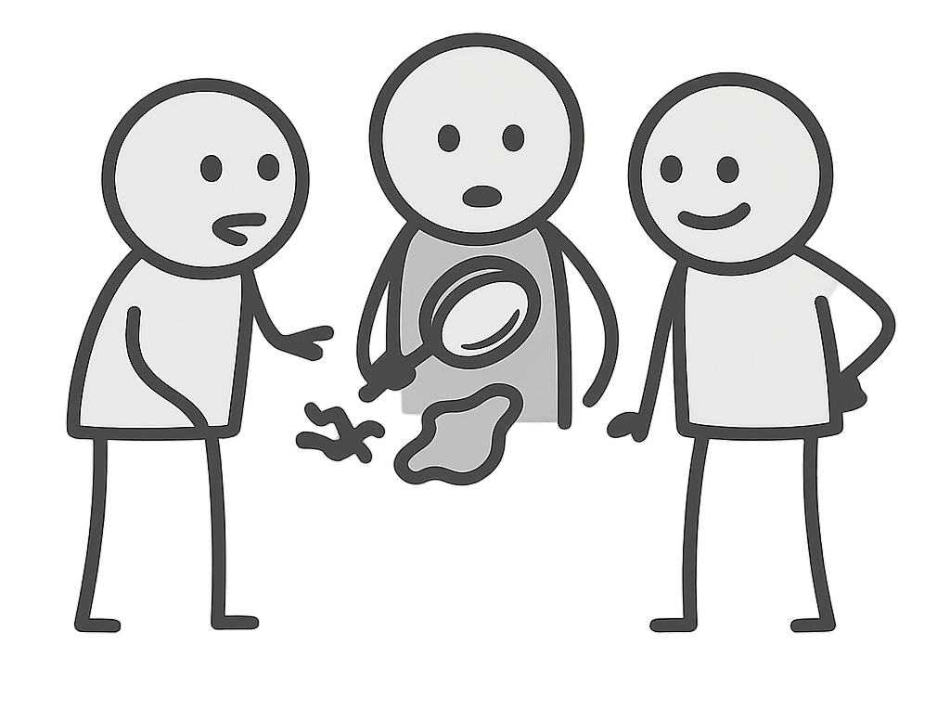
Bug Review
Notes:
CORNELIA: Scheduled a regular bug review with the engineering manager, product owner and the QA. A meeting to review and prioritize Bugs, look at trends, discuss improvements

Slide 15
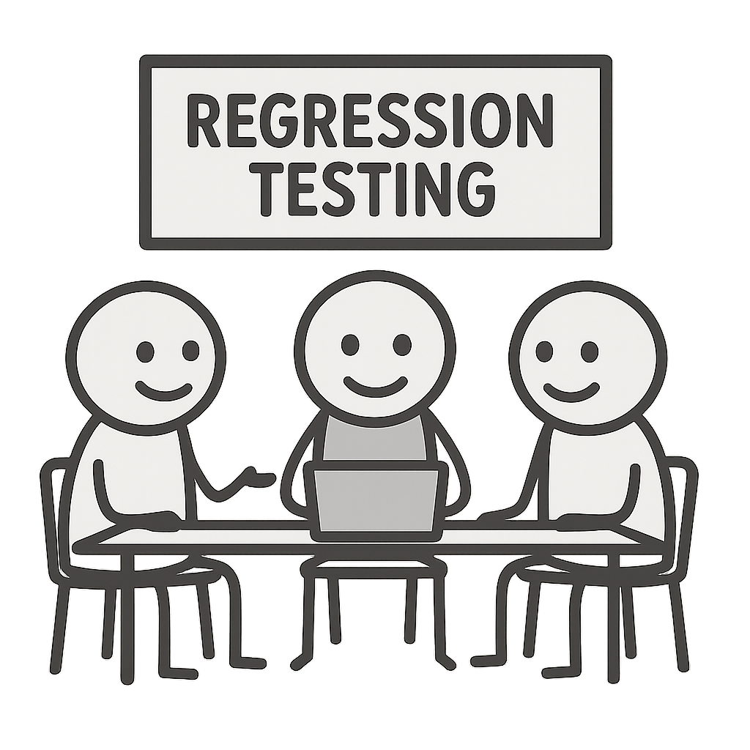
Team Regression Testing
Notes:
MAILE: and took a closer look at the team regression testing: started to try different test management systems, allocating a specific timeslot for regression testing, even having a zoom call for team when doing regression.
Think about adding: the whole team meeting is for increasing team’s knowledge and testing skills

Slide 16
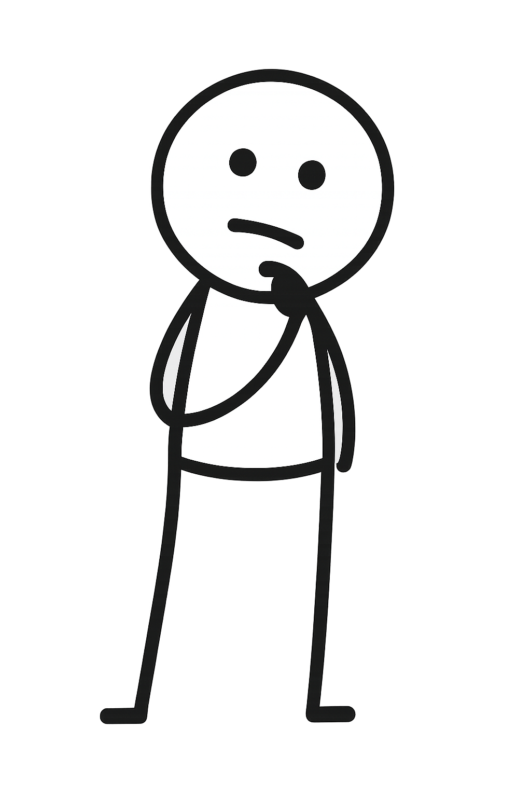
2023
Notes:
ONE YEAR LATER
C: It felt like we were just some baby steps away from the beginning, and I understood that I lacked support like Maile did.
Fortunately my EM realized how impactful quality assistance could be and from there on things started to smooth out.
Walkthroughs started to become a regular step of the development process, we carved time to prioritize or cancel a lot of bugs, and regularly reviewed the bug backlog. The bug review meetings I explained earlier? We created dashboards with quality metrics that we looked at
Given the success of feature-leading, we also started with that, and paired with amigos and refinements, our tickets have never looked better!
M: Bugs count had reduced. Overall my team was doing very well with the quality assistance: domain knowledge got stronger for everyone because of the walkthroughs. Also ownership of our product increased. Delivery speed and quality was getting better. Automated tests were a normal part of every feature. Engineering manager was happy and I was happy. I did not feel as the bottleneck anymore, I could see my teams confidence about testing growing. It was just left to occasionally remind some people that automation is not some special case happening someday, but coming with everything we build.

Slide 17

2024
Notes:
TWO YEARS LATER
C: Two years passed. Finally it has all paid off – in the beginning of this year we realized, to our surprise, that we have reached a magical land called Zero Bug Policy! We have regular bug review meetings with the whole team, our automation coverage has vastly improved – most of our existing features are covered with tests and estimates for tickets are given so that testing is included in the estimation
M: We have now some processes very much in place. For example the feature leading, bugs review, having testing notes in every ticket and walkthroughs. The shift has happened that team does not always need to have the QA in the walkthroughs, but can do some tasks by their own. Bugs move more often into development than to backlog. Production bugs are rare these days :)
Delivery speed hasn’t changed (remember the disclaimer!), reopens during walkthrough stage are rare, production bug count has greatly decreased

Slide 18



Notes:
Cornelia: So now that we’ve moved from this to this… what’s next? We still have jobs as you can see :D Our focus is on: Planning testing activities for the team Creating and reviewing test plans, Shaping testing strategies, Advising on automation coverage, Coaching developers on testing practices, Monitoring production and quality trends, Investigating incidents and follow-ups, Supporting bigger, cross-team topics.
MAILE: As the company keeps growing, new team splits become inevitable. And with that, the challenge of one QA supporting multiple teams is waiting just around the corner. In our case it is kind of logical because we have the domain knowledge to support more than one team, so let's do it! Of course, there’s a catch. For this to work, the teams themselves need to grow more independent. QA can guide and support, but the mindset and daily responsibility for quality must live in the teams. They need to uphold the standards, keep quality high, and treat it as part of their own work — not something waiting for the QA safety net.

Slide 19
TL;DR
Notes:
CORNELIA: WE have gotten to the end of our talk so let’s warp things up. Here are three key takeways – or to be more precise, steps you can take to start implementing quality assistance framework in your teams.

Slide 20
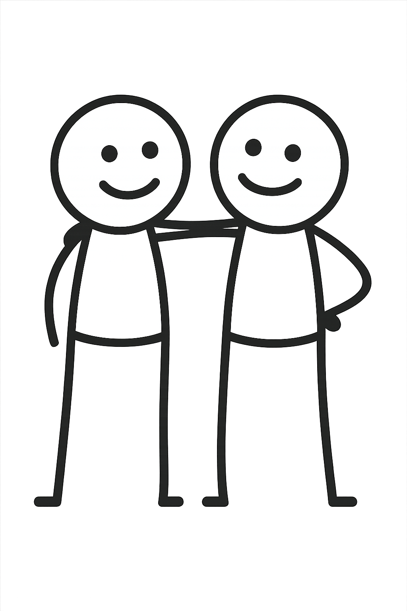
Find one ally inside the team
Notes:
MAILE: Pick a person that seems to be most difficult, or opinionated, or just the one whose opinion the team cares about most.

Slide 21

Start from planning phase
Notes:
CORNELIA: Be proactive from the start – start of a project or any kind of feature development. Start by bringing quality and testing into the conversations as early as possible. By being present in the planning, refinings, amigos and kickoffs- however you want to name them you can surface risks, clarify requirements and dependencies and think about testability with your whole team.

Slide 22
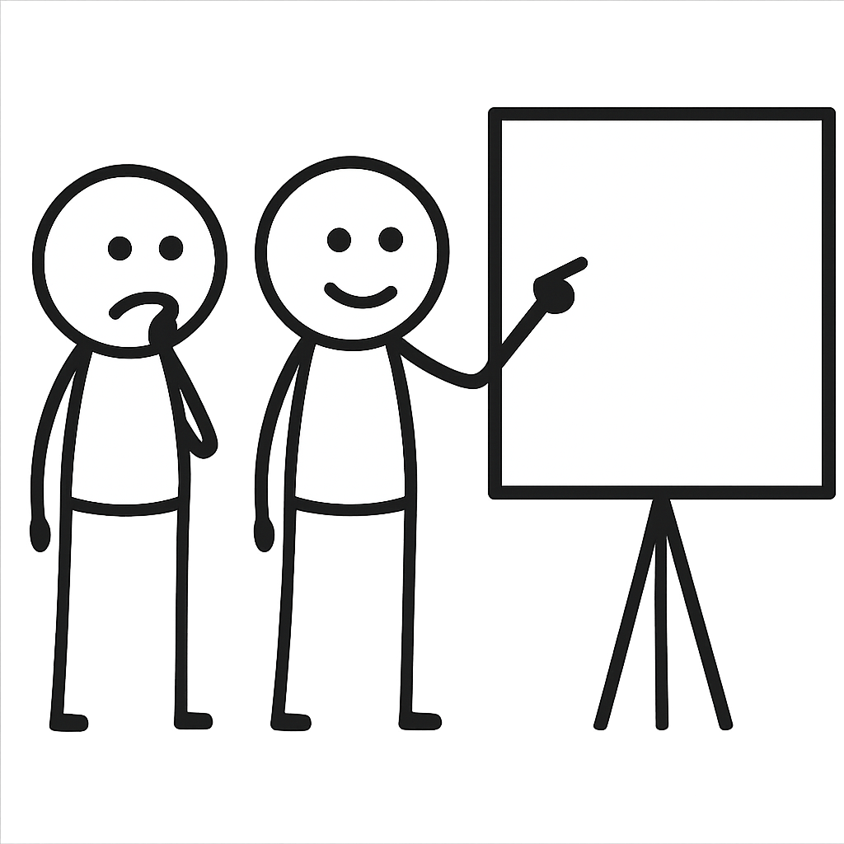
Practice Walkthroughs
Notes:
MAILE: Grow the ownership and domain knowledge, listen to your team members: sometimes they just want someone to say "good work" or they want to show their testing skills. If possible try not to limit them too much with time. At least not in the beginning. Teach the team that walkthrough is about showing the work that has been done, being proud of it and verifying it has high quality before reaching production. For the walkthrough to succeed, the ticket needs to have informative comments from the dev and from the code reviewer so that when doing the actual walkthrough participants can concentrate on edge cases and /or other missed testing flows.

Slide 23
Thank you!

Slide 24


